Slide 1

Cybersecurity club

Slide 2

AGENDA
Cyber News!!!
File Carving
Magic Bytes
Docter
Social Media
Questions

Slide 3
Cyber news!!!
150,000 Sites Compromised by JavaScript Injection Promoting Chinese Gambling Platforms
The redirections have been found to occur via JavaScript hosted on five different domains (e.g., "zuizhongyj[.]com") that, in turn, serve the main payload responsible for performing the redirects.
EncryptHub Exploits Windows Zero-Day to Deploy Rhadamanthys and StealC Malware
The vulnerability in question is CVE-2025-26633 (CVSS score: 7.0), described by Microsoft as an improper neutralization vulnerability in Microsoft Management Console (MMC) that could allow an attacker to bypass a security feature locally. It was fixed by the company earlier this month as part of its Patch Tuesday update.

Slide 4

File Carving
What is file carving?
The process of reconstructing a file and its data by accessing the raw data stored
The type of file that people hide things in are image and audio files
The file in the GitHub looks like a regular image file but it has some hidden information inside of it
First, we need to find what type of file it is
Next, we have to find out what hidden files are inside
Finaly, we have to extract the data

Slide 5
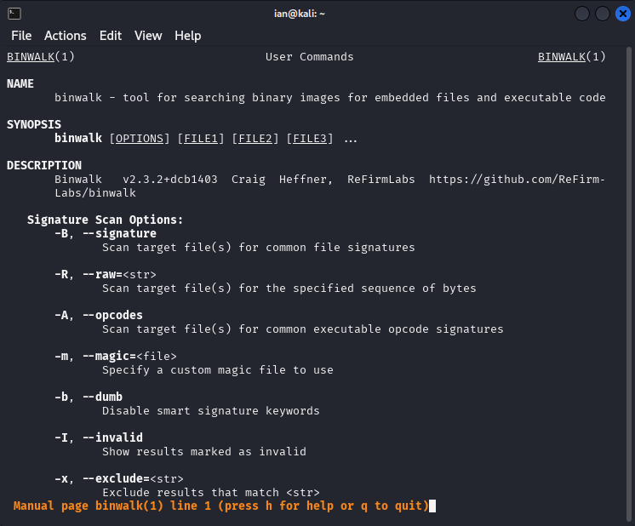
File carving walk through
Use the command file <file_name>
This is to find the file type
Use binwalk <file_name>
This is used to find hidden files within
Use binwalk --extract --dd “png:png” <file_name>
This is to extract all the files from the file
Open the folder that is made from binwalk
This will have the hidden file inside

Slide 6

Magic bytes
What are magic bytes (file signatures)?
Specific byte sequences placed at the beginning of a file to identify the file type or format
First find out what type of file it is supposed to be
Next, change the hex to the correct file header
Finaly, look at the fixed file

Slide 7
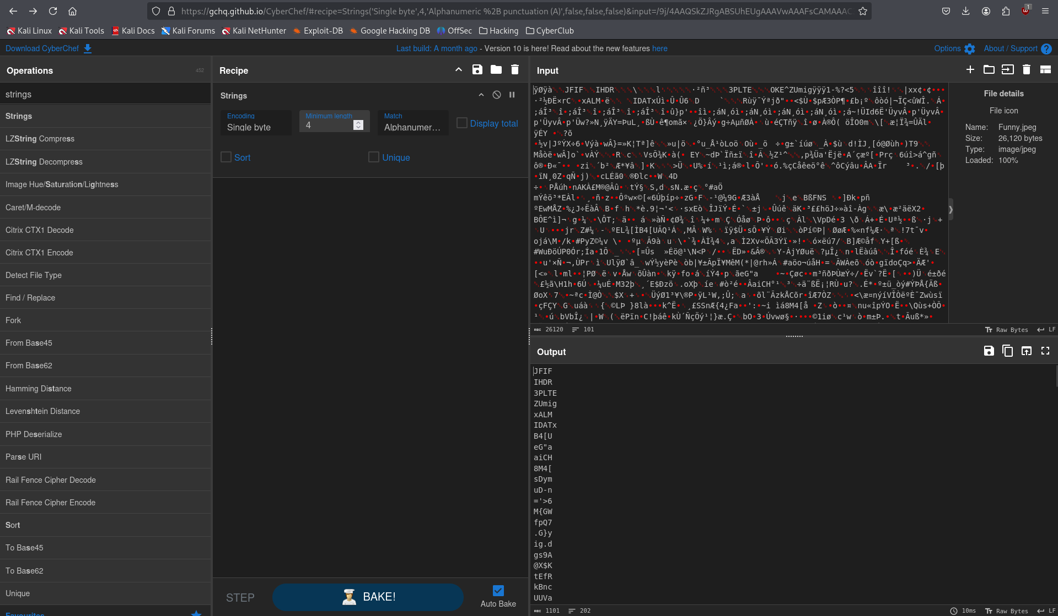
Magic bytes walk through
Use the command strings <file_name> or import the file into cyberchef with To Hex or Strings
We know it has been tampered with because it doesn't show an image and IHDR isn't for jpegs
IHDR is a png format, so we know the magic bytes are wrong
Use HexEd.it to exit the hex to a png format
png is only 8-bytes long and jpeg is 12-bytes
Hex code: 89 50 4e 47 0d 0a 1a 0a 00 00 00 0d

Slide 8

docter
There is a hidden image inside of this docx file
A Microsoft Word document, or .docx extension file is actually a ZIP compressed archive
This means that you can rename the .docx part to .zip
Decompress the file
Use unzip <file_name>
Find the hidden image

Slide 9



Social Media
Instagram
Discord
https://dsc.gg/bsucyber
BennyLink (Attendance)

Slide 10

Questions

